Slide 1
Marshall Park BSA Eagle Scout Project
Pull Up and Parallel Bars Exercise Station
Presented by: Thatcher Samuels

Slide 2
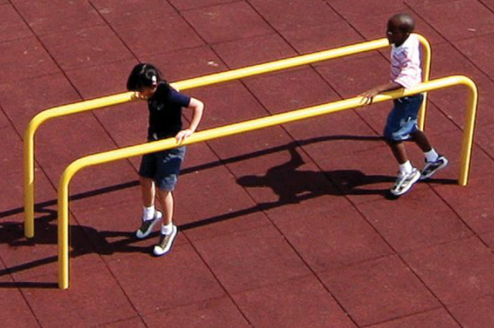
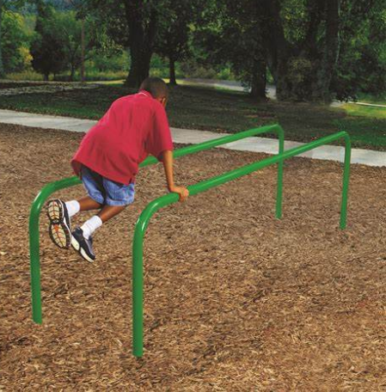
Parallel Bars
Parallel Bars

Slide 3
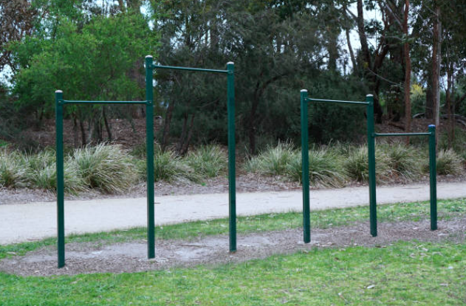
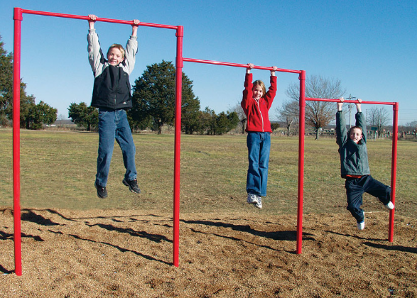
Pull Up Bars
Pull Up Bars

Slide 4
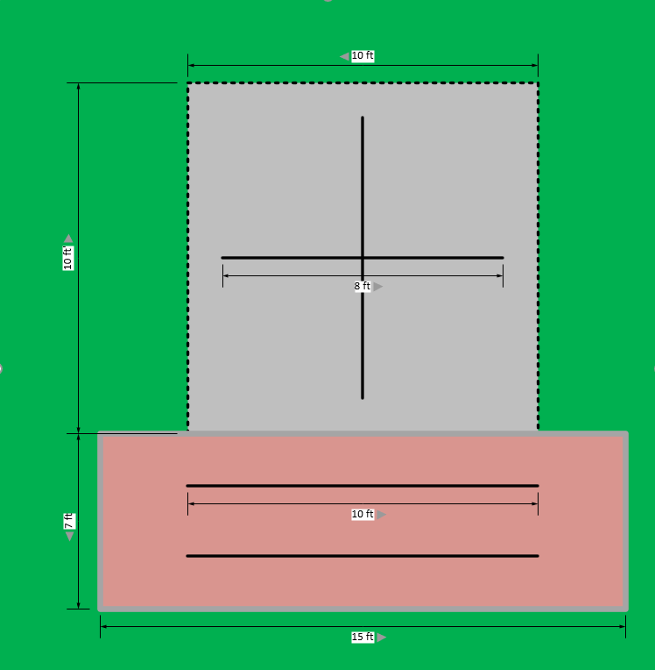
Overhead View
10’ X10’ Concrete Pad with
4 Pull Up Bars
7’ x 15’ Mulched Area with
4” high concrete curb
surrounding
10’ long Parallel Bars
2’ apart
Pull Up Bars

Slide 5
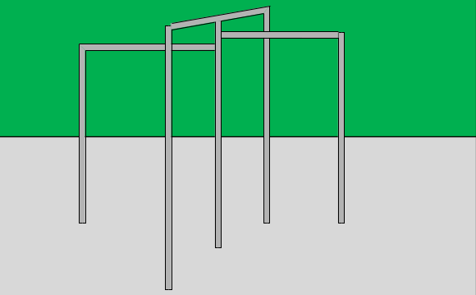
Side view of Pull Up
Bars to show
Height difference
And Configuration
Pull Up Bars
Pull Up Bars

Slide 6
Cost Breakdown
Materials List
Pull Up Bars: $360
1” SCH40 Galvanized
Galvanized Fittings
Parallel Bars: $540
1” SCH40 Galvanized
Galvanized Fittings
Concrete $800
Mulch (Fine Wood) $350
Caulk $180
Incidentals $80
Total: $2,310

Slide 7
Thank you for your consideration!
Questions?

